Slide 1

Receipt Keeper
Receipt Management Application
Changho Choi
Hassan Nahhal
Nicholas Collins
SungJoe Kim
Mobile Solutions Development

Slide 2





Team members
Changho Choi
Mobile UI/ Web Sync.
Hassan Nahhal
Mobile UI/ Back-End
Nicholas Collins
OCR/ Mobile Front-End
SungJoe Kim
Web UI/ Front/ Back-End
Notes:
Move this slide when Q&A sections

Slide 3
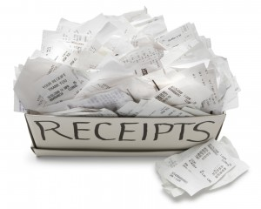
Introduction
be familiar with spending
avoid impulse buying
manage your money
save you time & effort
here’s the way …
Notes:
Sequence
Introduction / Agenda : Hassan
Problem/Solution : Nick
Tech. : Chang
Mobile Features : Hassan
Web Features : Joe
Plan/Conclusion :Nick
Introduction : Hassan will prepare expression and proper images

Slide 4

Agenda
problem
solution
technologies
methodologies
features (mobile/ web)
future plans
conclusion
Notes:
What’s it (This slide is not necessary)

Slide 5



Problem
forget stuff bought
tracking all of this is a handful
strict budget
alternative is not ultimate
a long process to start using it
offer limited functions
focused on private, personal use
Notes:
Here’s Nick

Slide 6




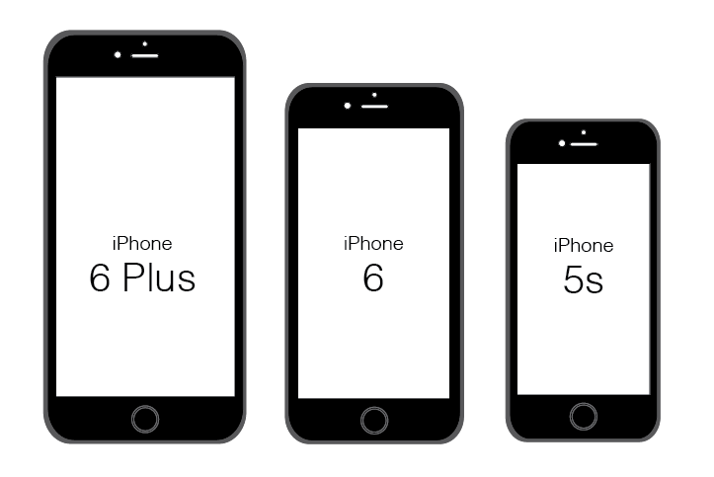


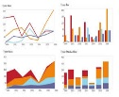
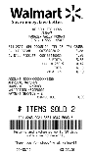
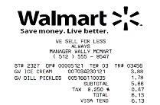
Our Solution
quick and easy access to start
no extra devices required
scan receipt & store it online
filter, search for receipts, export as files
generate charts, reports feedback
support working in groups

Slide 7






Work Process
scan
receipt
output
data
save in
database
track
expenses
view
anywhere
Notes:
From here, Chang

Slide 8




















Technologies
BAAS
DAAS
web
PAAS / SVC
mobile

Slide 9



Methodologies
development methodology
Agile Unified Process (2 week iterations)
source control & change management
3 GitHub repositories
master and branch (dev_prod)
wiki to keep track of outcome
issues tracking to assign fixes or tasks
communication
Slack and regular meetings
Notes:
Use Icon to explain above text descriptions
Modify and improve from Chang and add proper images

Slide 10
Domain Model
User
Receipt
File
*
*
1
1
0..
*
<<belongs to>>
0..
<<belongs to>>
Store
*
0..
Group
Tag
*
0..
*
0..
<<belongs to>>
Category
Notification

Slide 11

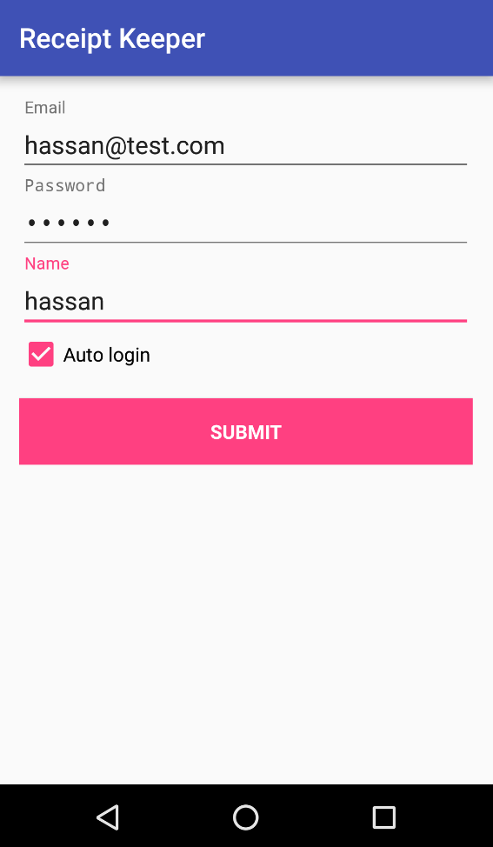
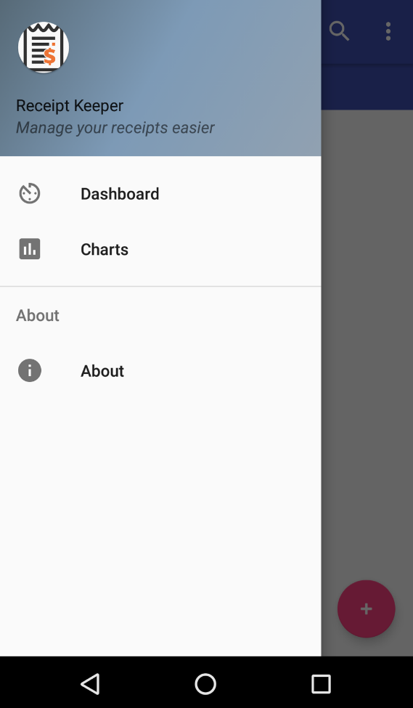
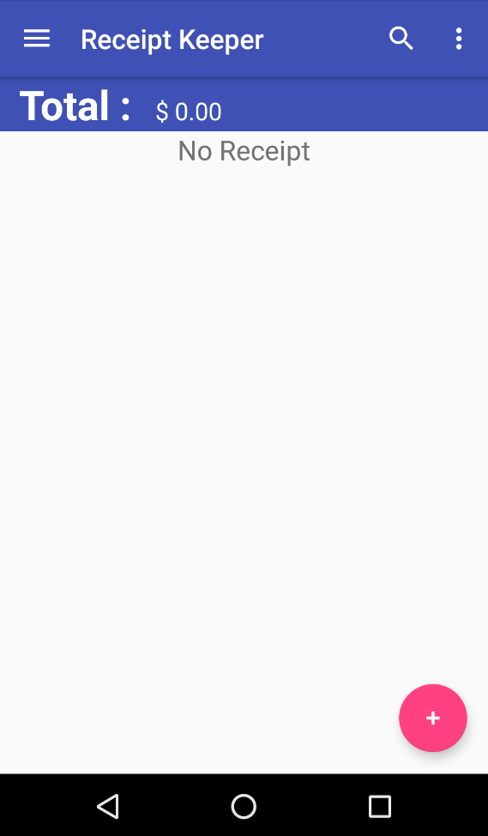
Features (mobile app)
sign up/in
main page
sliding view
Notes:
From here : Hassan
Screenshots for major actions and short words

Slide 12
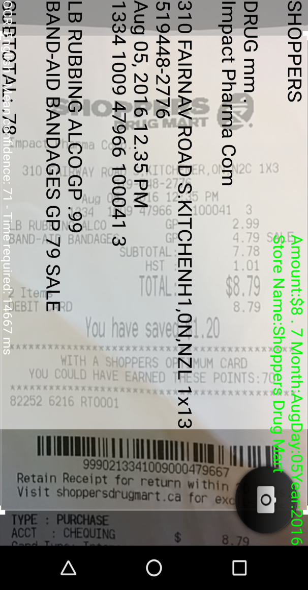
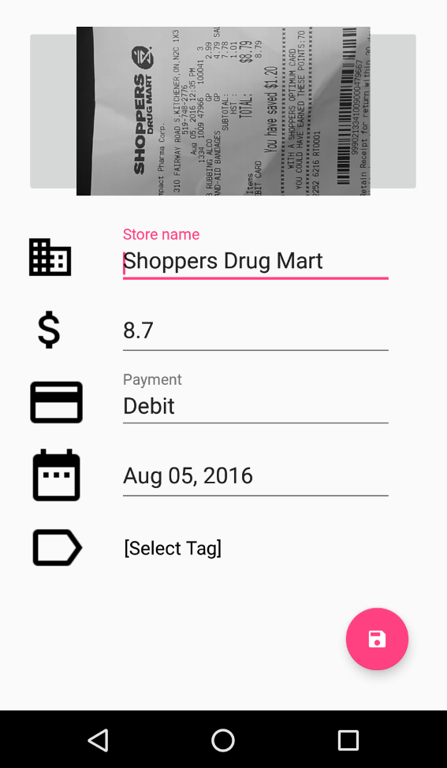
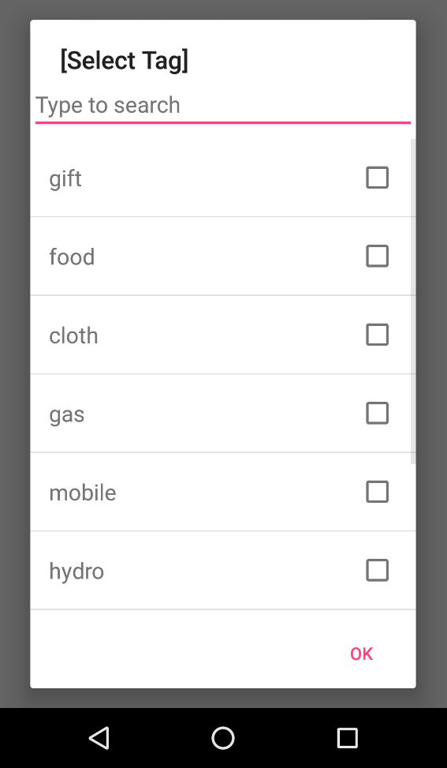
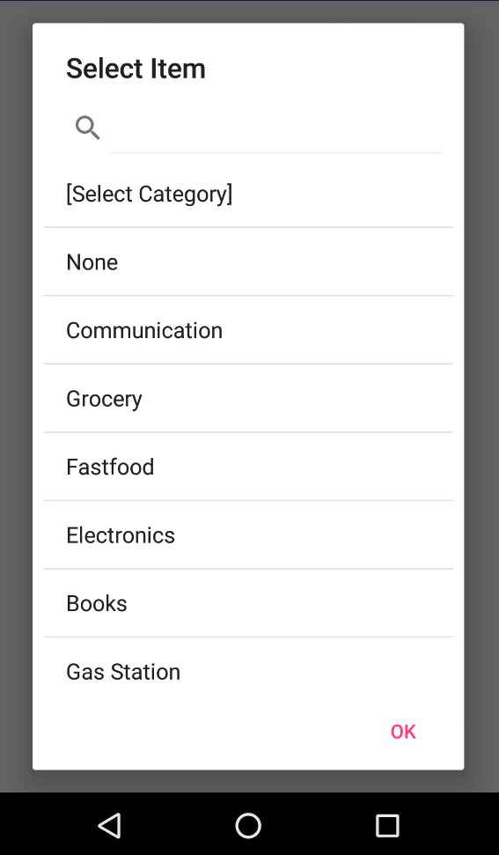
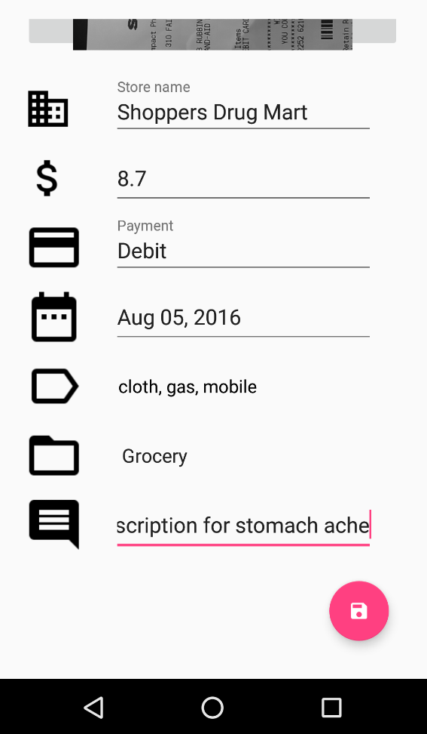
Features (mobile - cont.)
add tag
select category
save
receipt
data
collected through text recognition
scanning receipt

Slide 13
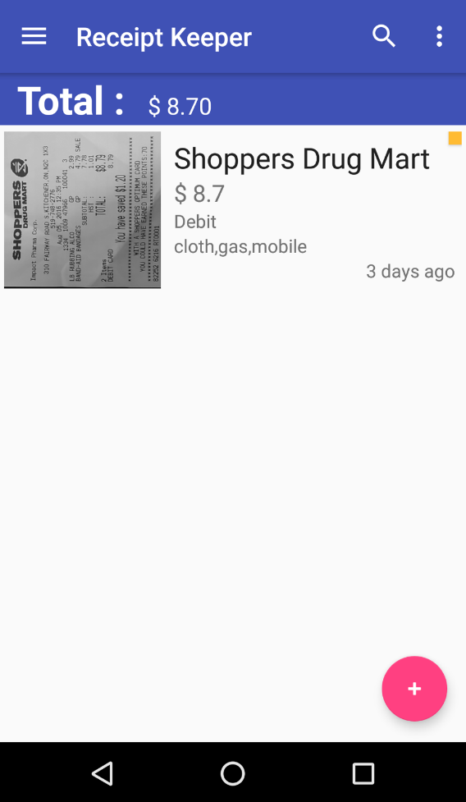
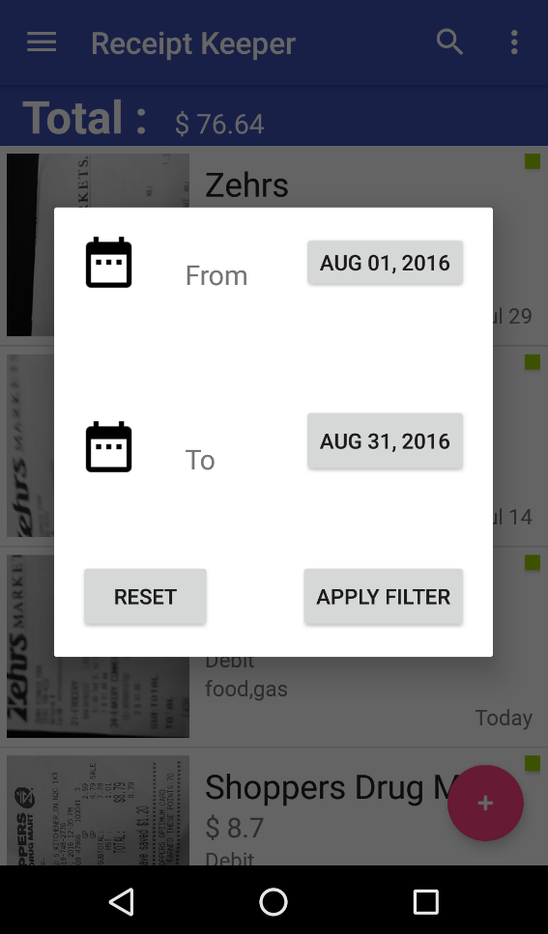
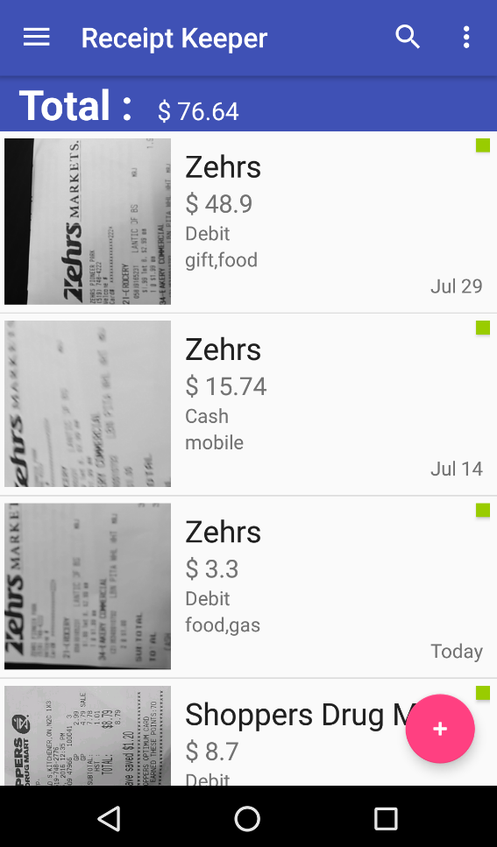
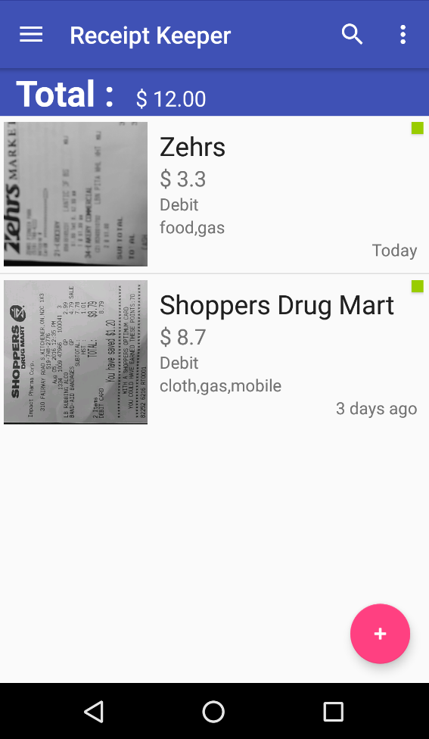
Features (mobile - cont.)
apply filter…
web sync.
filter results
receipts
list

Slide 14
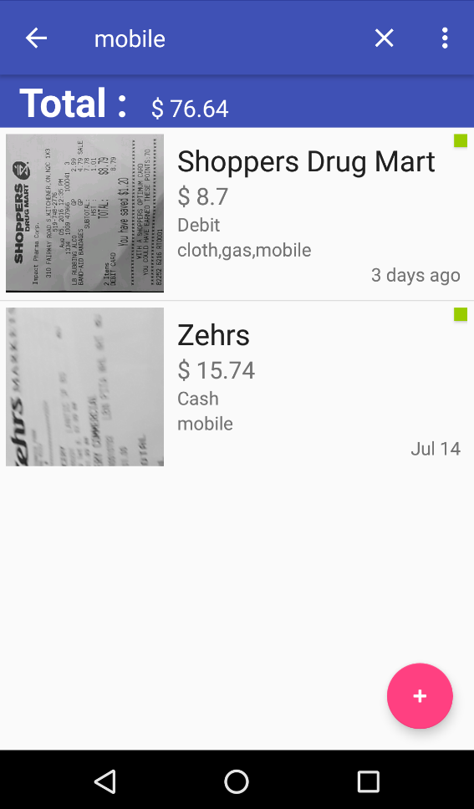
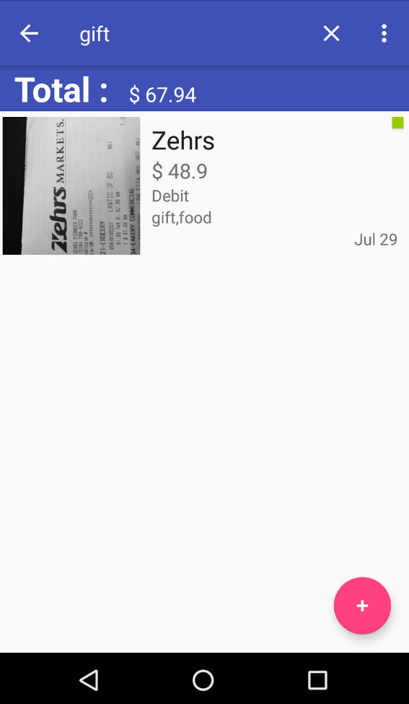
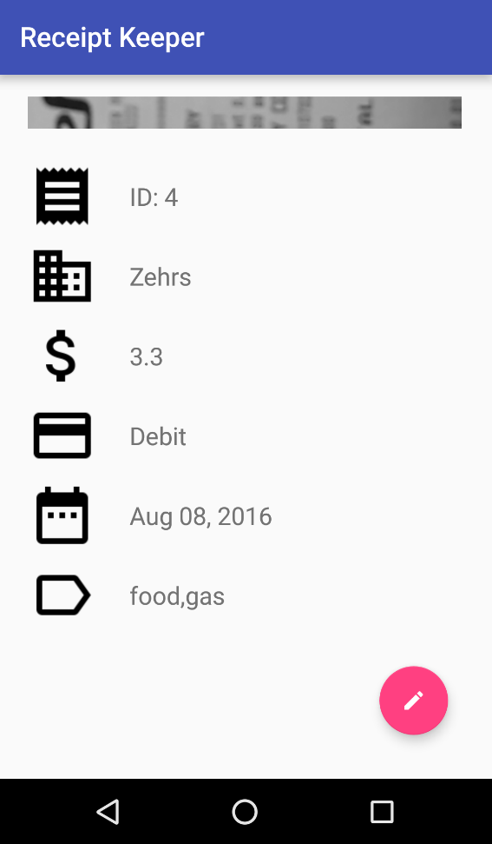
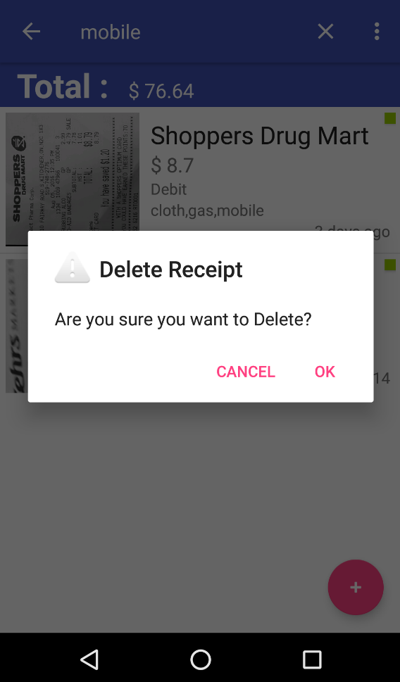
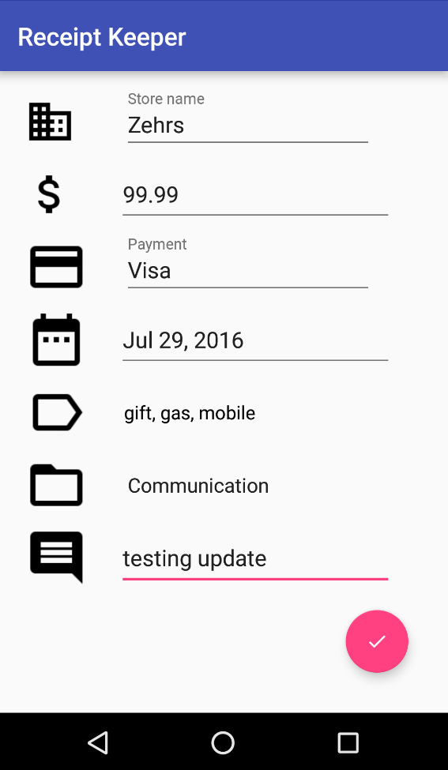
Features (mobile - cont.)
long touch
short touch
view details
delete
update

Slide 15

Features (web app)

Slide 16
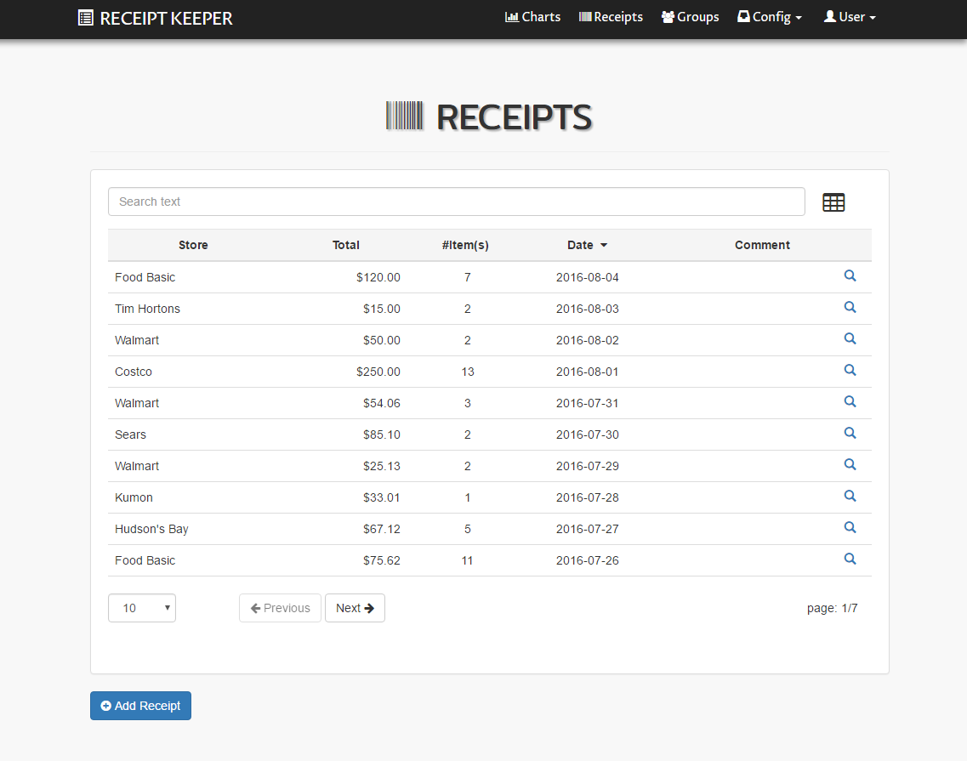
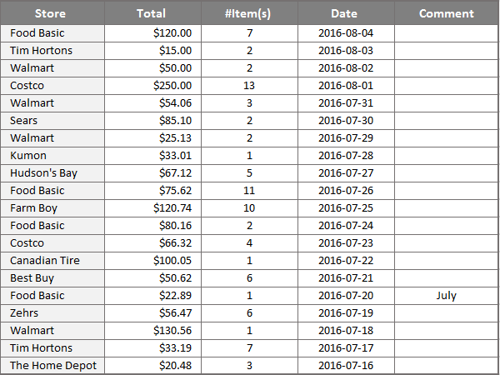
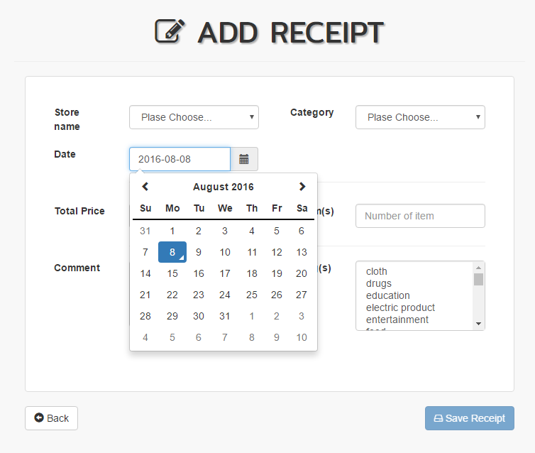
Features (web - cont.)
search/ sort/ pagination/ excel export

Slide 17
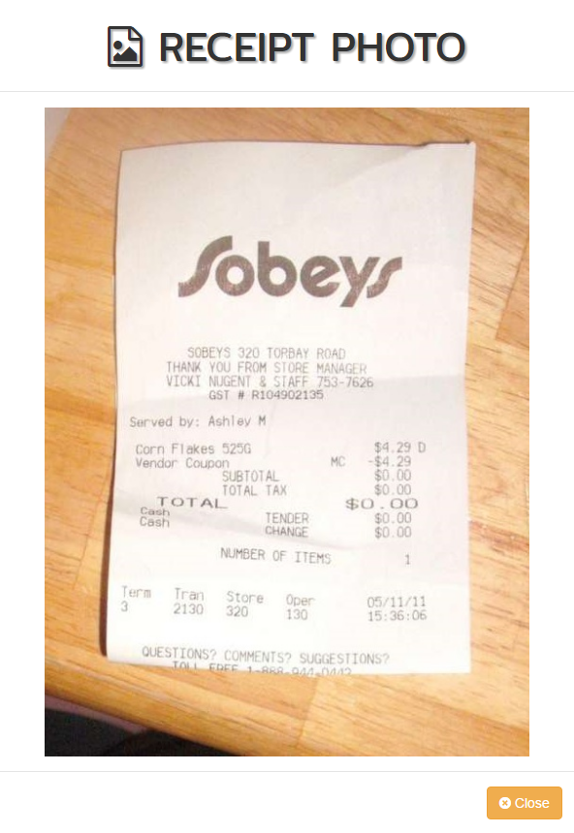
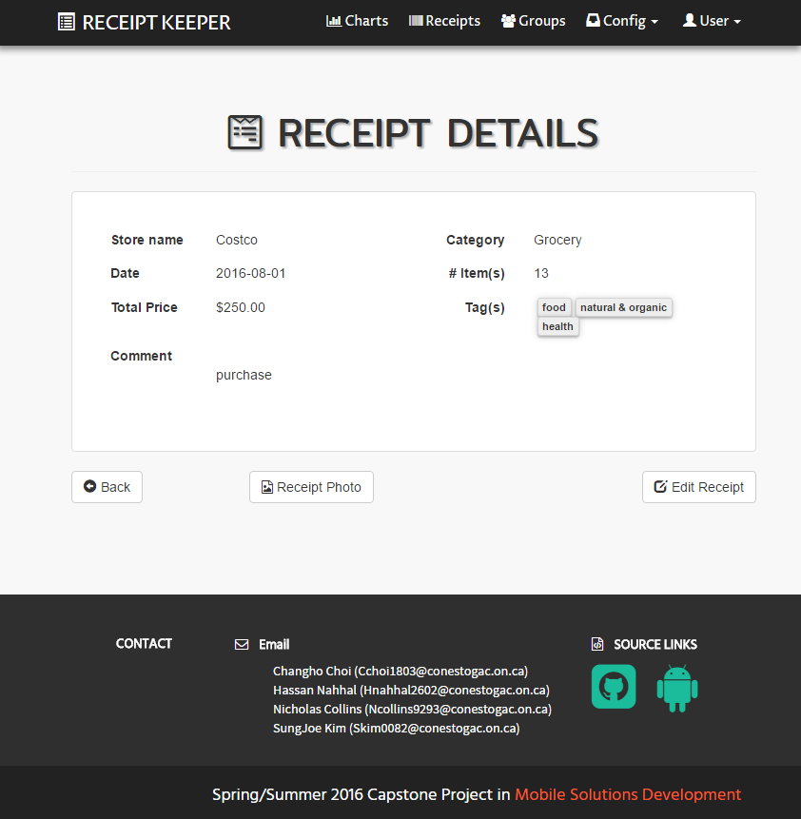
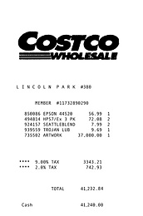
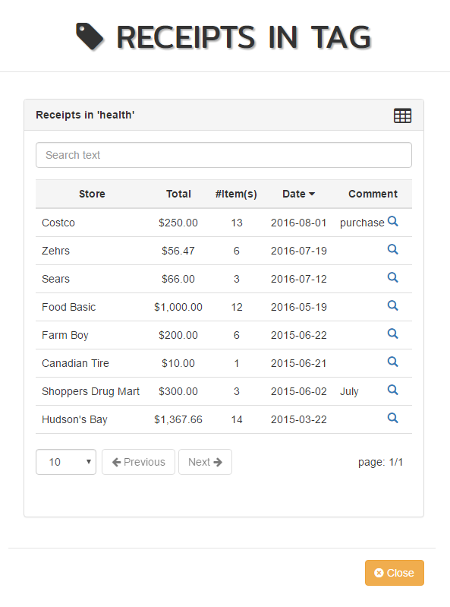


Features (web - cont.)
receipt photo/ extract receipts from tag

Slide 18
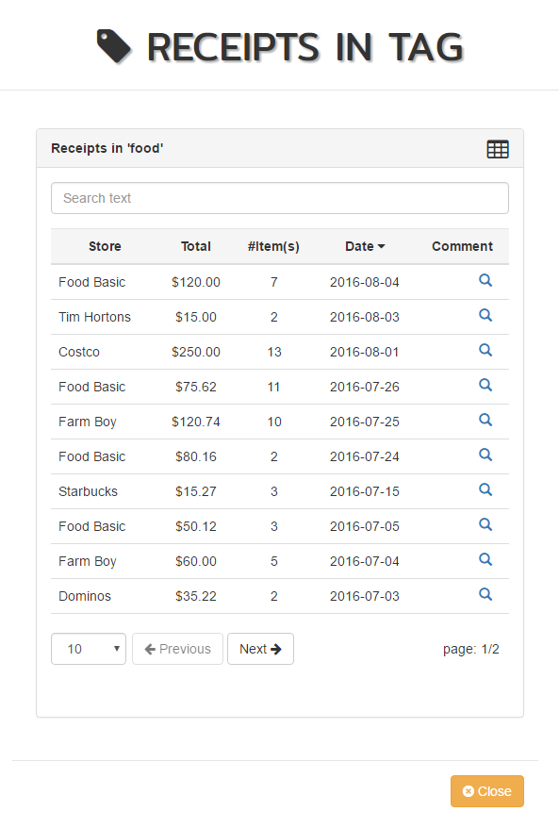
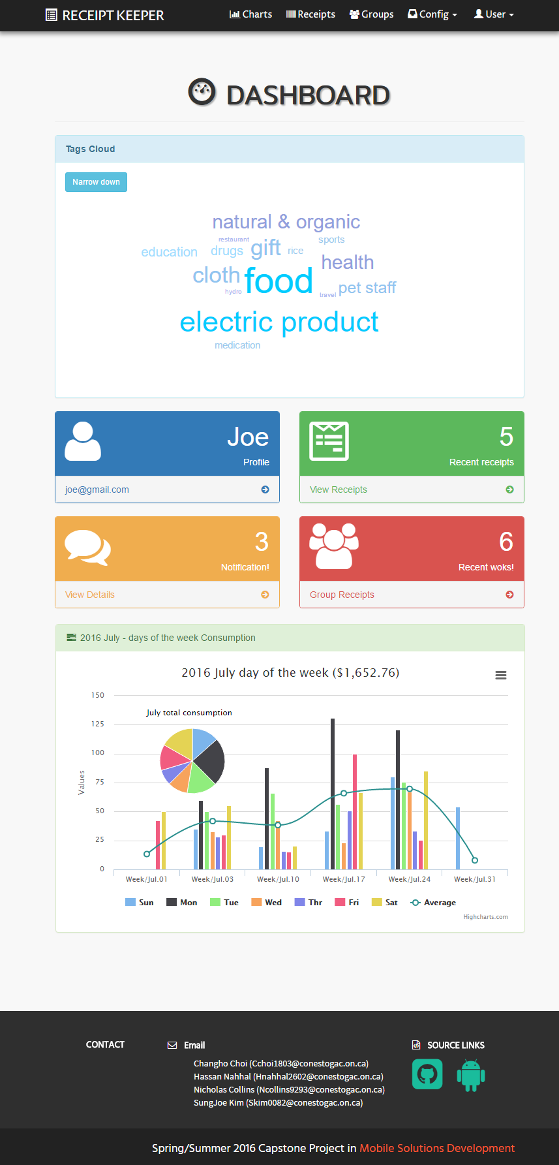
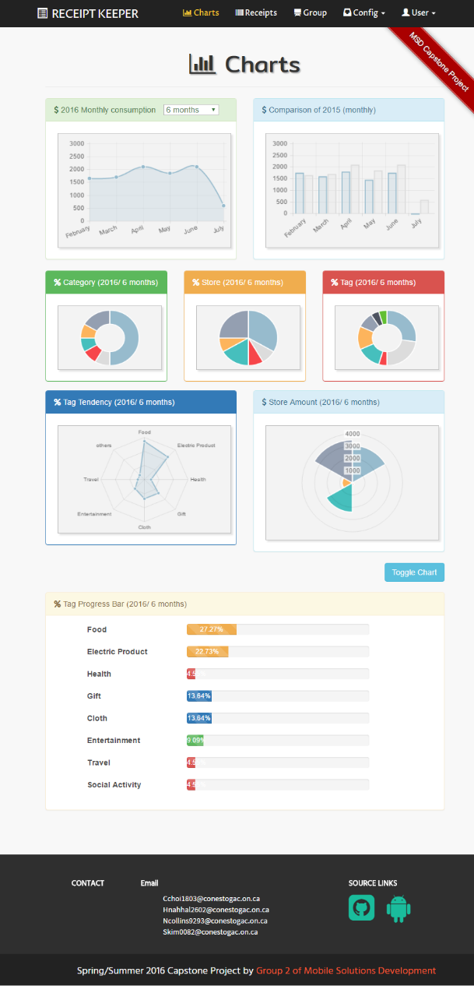
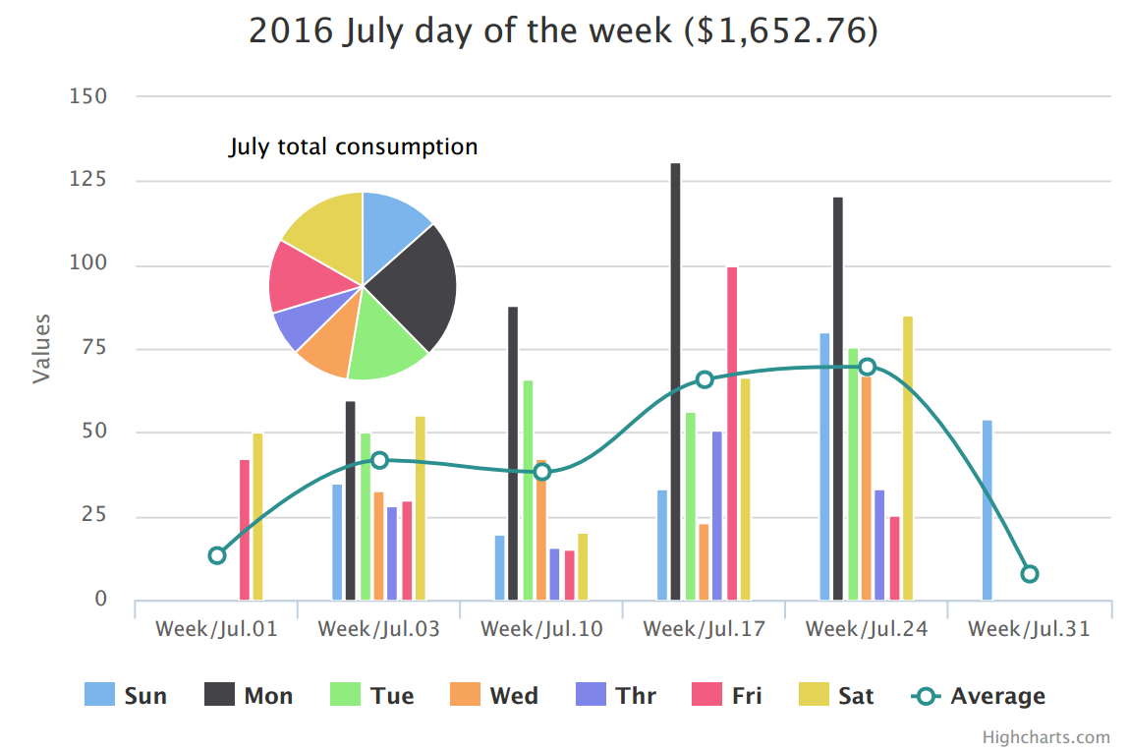
Features (web - cont.)

Slide 19
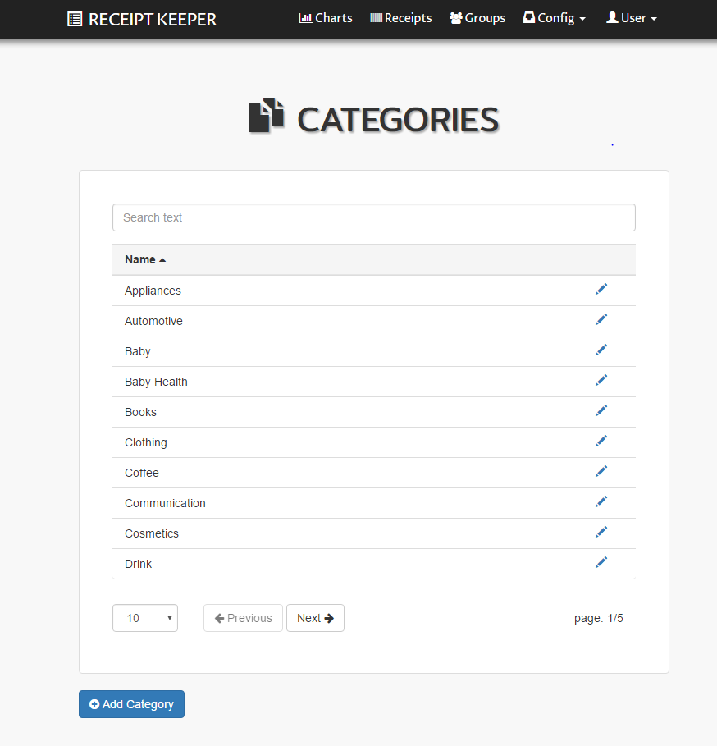
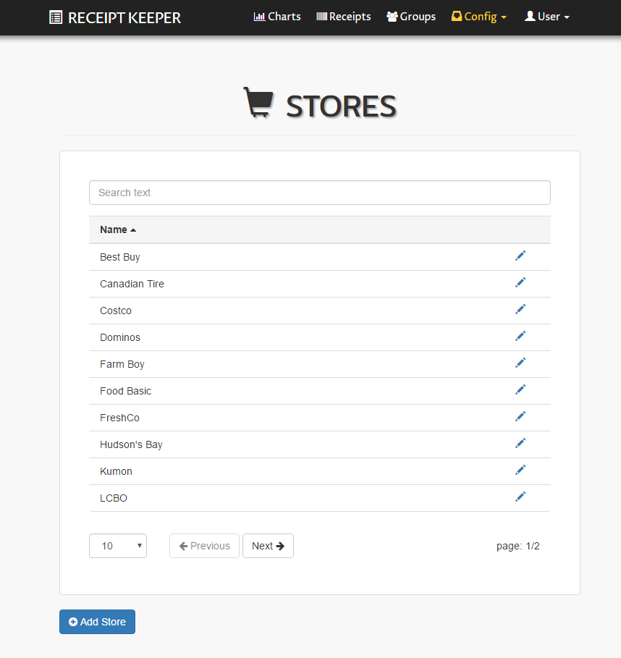
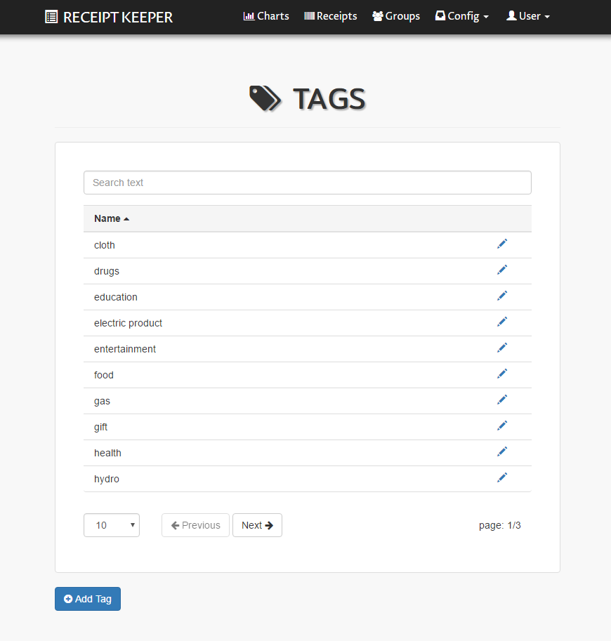



Features (web - cont.)
user organize data structure
category/ store/ tag
view reports based
on them

Slide 20
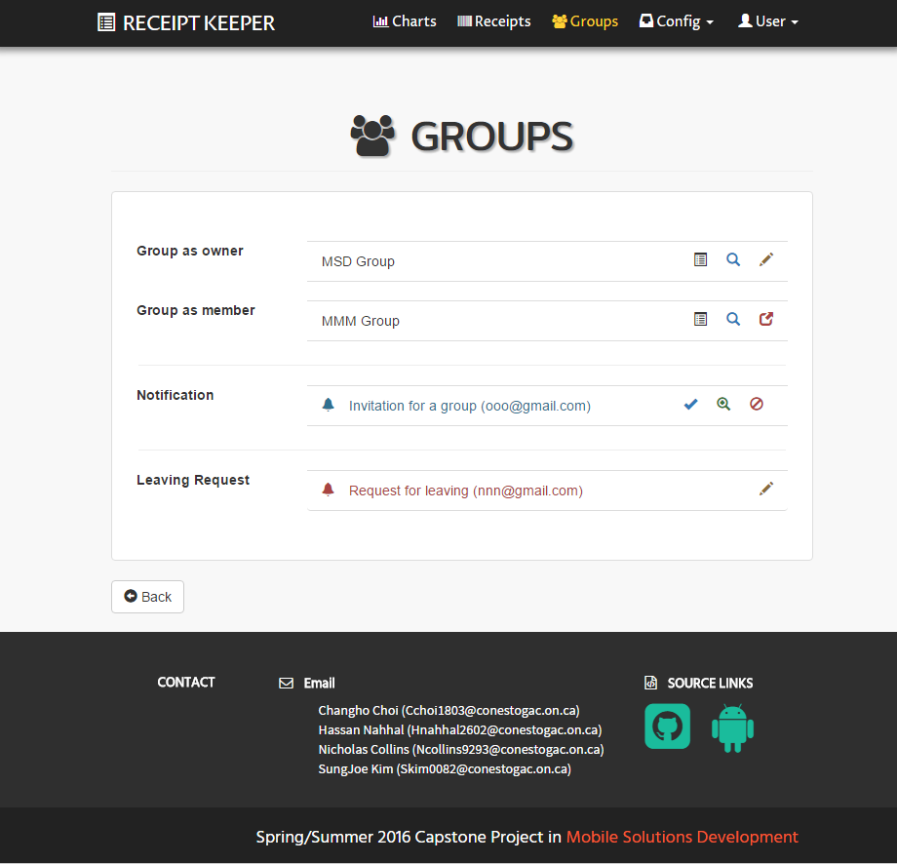
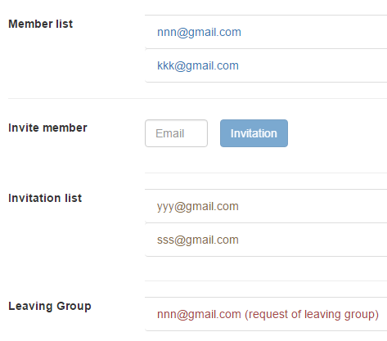

Features (web - cont.)
create group
works in group
invite member
store & share

Slide 21

Future Plans
save daily paperless receipts
import/export in various formats
switch between account type
combine multiple images
open CV to improve accuracy
track each member in group
retrieve from specific item
Notes:
Here, again Nick

Slide 22

Conclusion
scan receipts with mobile devices
save data local or online
track spending
view and export reports as files
provide various visual information
access anywhere/ anytime
support working in group

Slide 23
Receipt Keeper
Receipt Management Application
Changho Choi
Hassan Nahhal
Nicholas Collins
SungJoe Kim
Mobile Solutions Development

